Slide 1
Modern Systems Analysis and Design Eighth Edition, Global Edition Joseph S. Valacich Joey F. George
System Implementation

Slide 2
Learning Objectives
Provide an overview of the system implementation process.
Describe how software applications are tested.
Apply four installation strategies: direct, parallel, single-location, and phased installation.
List the deliverables for documenting the system and for training and supporting users.

Slide 3
Learning Objectives (Cont.)
Explain why system implementation sometimes fails.
Describe the threats to system security and remedies that can be applied.
Show how traditional implementation issues apply to electronic commerce applications.

Slide 4
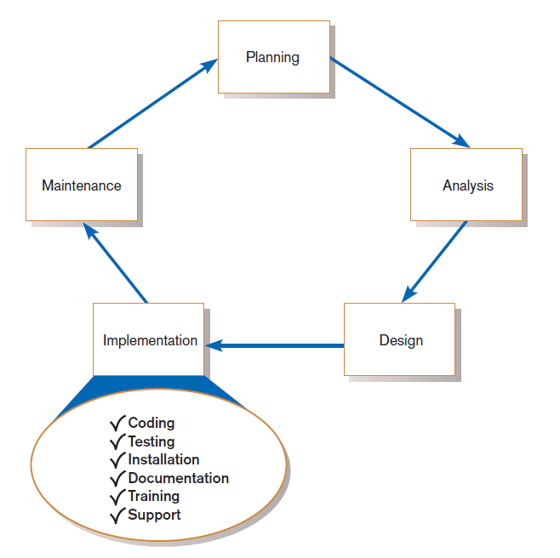
FIGURE 13-1
Systems development life cycle with the implementation phase highlighted
Notes:
We’ve completed the design phase and now enter the implementation phase. Coding is a big part of this. But keep in mind that this simplified SDLC may have many variations. If you’re using an agile methodology, you’ve probably already done quite a bit of coding, and even some testing during the design of the system.
The outputs of design were the design specification (for data, for business logic, for user interface, etc.). Now, we put these specifications into an actual, concrete, database and software system.
Implementation also has other important tasks, including testing, installation, documentation, training, and user support.

Slide 5
System Implementation
Purpose:
To convert final physical system specifications into working and reliable software
To document work that has been done
To provide help for current and future users

Slide 6
System Implementation (Cont.)
Six major activities:
Coding
Testing
Installation
Documentation
Training
Support

Slide 7
The Process of Coding, Testing, and Installation
Coding
Physical design specifications are turned into working computer code.
Testing
Tests are performed using various strategies.
Testing is performed in parallel with coding.
Installation
The current system is replaced by a new system.
Notes:
Again, let’s consider agile methodologies and prototyping. With these techniques, coding is taking place all the time, even during analysis and design, and some sort of testing (at least debugging) is happening also. The main point of implementation is that the system becomes available to all users, and that “final coding” and more comprehensive texting is taking place. But even here, the notion of “final” coding isn’t correct. There will be enhancements and corrections to do even after the system is installed and operational; this is part of the final phase called maintenance.

Slide 8
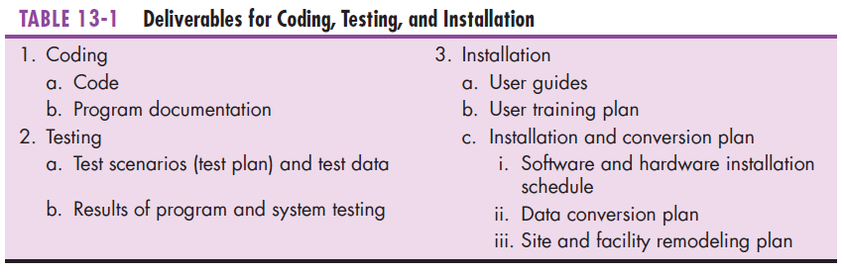
Notes:
Here is a table showing the main elements of coding, testing, and installation.

Slide 9
Documenting the System, Training Users, and Supporting Users
Two audiences for final documentation:
Information systems personnel who will maintain the system throughout its productive life
People who will use the system as part of their daily lives
User Training
Application-specific
General for operating system and off-the-shelf software
Notes:
Some documentation is intended for the technical people and other documentation is intended for the end users.

Slide 10
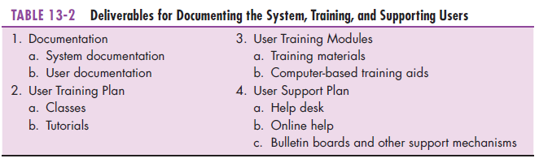
Notes:
System documentation is for the IS staff, and of course user documentation is for the end users. There are many techniques for training and supporting end users.

Slide 11
Software Application Testing
A master test plan is developed during the analysis phase.
During the design phase, unit, system and integration test plans are developed.
The actual testing is done during implementation.
Written test plans provide improved communication among all parties involved in testing.
Notes:
Testing was not discussed very much when we talked about the analysis and design phases. But during these phases we should be cognizant of how we will do the testing, and planning accordingly.
We’ll talk about the distinction between unit, system, and integration testing shortly.

Slide 12
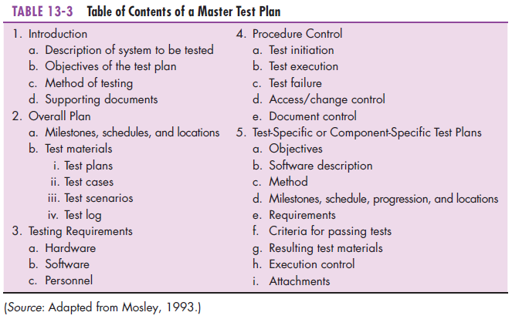
Notes:
As you can see, a master test plan can be very comprehensive. Some companies have entire IS task groups whose entire purpose is to test systems. If not, the developers will typically be the testers. Ultimately, user testing will also take place, because the final arbiters of whether the system meets requirements is going to be the user. We’ll talk about user acceptance testing shortly.

Slide 13
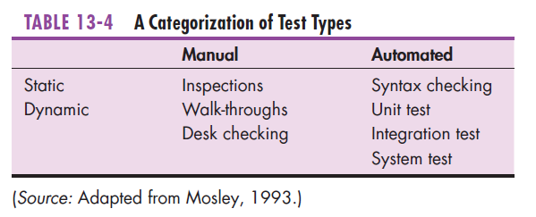
Seven Different Types of Tests
Static or dynamic techniques
Static testing means that the code being tested is not executed.
Dynamic testing involves execution of the code.
Test is automated or manual
Automated means computer conducts the test.
Manual means that people complete the test.
Notes:
We’ll look at static vs. dynamic and automated vs. manual methods.

Slide 14
Seven Different Types of Tests
Inspection: a testing technique in which participants examine program code for predictable language-specific errors
Walkthrough: a peer group review of any product created during the systems development process, including code
Desk checking: a testing technique in which the program code is sequentially executed manually by the reviewer
Notes:
These are examples of manual, static methods. All of them involve people liking at program code.

Slide 15
Seven Different Types of Tests (Cont.)
Unit testing: each module is tested alone in an attempt to discover any errors in its code
Integration testing: the process of bringing together all of the modules that a program comprises for testing purposes
Modules are typically integrated in a top-down incremental fashion.
Notes:
These are dynamic methods. Actually, unit testing tends to take place during the coding process, because individual coders are always debugging their code. Integration testing requires some coordination, because typically different people will code different modules.

Slide 16
Seven Different Types of Tests (Cont.)
System testing: the bringing together of all of the programs that a system comprises for testing purposes
Programs are typically integrated in a top-down, incremental fashion.
Notes:
An application doesn’t exist in a vacuum. It is part of a larger environment involving many other applications. We want to make sure that the actions of a new application doesn’t interfere with others.

Slide 17
Seven Different Types of Tests (Cont.)
Stub testing: a technique used in testing modules, especially where modules are written and tested in a top-down fashion, where a few lines of code are used to substitute for subordinate modules
Notes:
Because top-level modules contain many calls to subordinate modules, you may wonder how they can be tested if the lower-level modules haven’t been written yet. Stub testing allows this. Stubs are two or three lines of
code written by a programmer to stand in for the missing modules. During testing, the coordinating module calls the stub instead of the subordinate module.

Slide 18
The Testing Process
The purpose of testing is to confirm that the system satisfies the requirements.
Testing must be planned.
Test case is a specific scenario of transactions, queries or navigation paths.

Slide 19
The Testing Process (Cont.)
Test cases represent either:
Typical system use
Critical system use, or
Abnormal system use.
Test cases and results should be thoroughly documented so they can be repeated for each revision of an application.

Slide 20
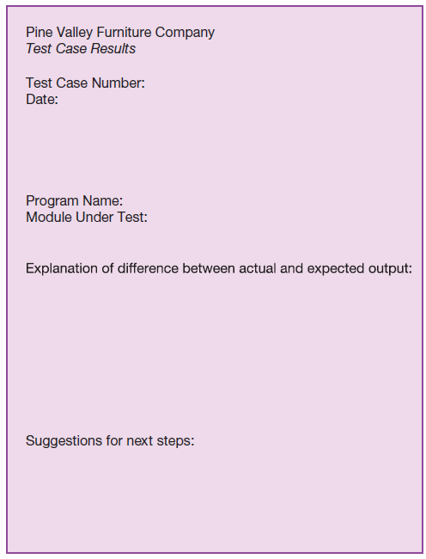
FIGURE 13-4
Test case results form
(Source: Adapted from
Mosley, 1993.)
Notes:
The people who create the test cases should not be the same people as those who coded and tested the system. In addition to a description of each test case, there must also be a description of the test results, with an emphasis on how the
actual results differed from the expected results, as we see in this figure. This description discusses why the results were different and what should be done to change the software. This description will then suggest the need for retesting, possibly introducing new tests to discover the source of the differences.

Slide 21
Testing Harness
Automated testing environment
Reviews code for:
Errors
Standards violations
Other design flaws
Expand the scope of the tests beyond the current development platform
how stable is the code? Does the code follow standard rules?
Will the code work across multiple platforms? When deploying large-scale, multi-platform projects, automatic code review systems have become a necessity.
Notes:
Testing often requires a great deal of labor. Manual code reviews can be very time consuming and tedious work; and, most importantly, are not always the best solution. The testing harness provides a computerized environment that helps to automate and simplify the testing process..

Slide 22
Combining Coding and Testing
Coding and testing often go together.
Big companies have dedicated test staff.
With eXtreme programming (XP) a common technique is refactoring.
Refactoring = making a program simpler after adding a new feature

Slide 23
Acceptance Testing by Users
Acceptance testing: the process whereby actual users test a completed information system, the end result of which is the users’ acceptance of it
Notes:
The ultimate arbiters of whether a system is going to be useful are, of course, the users. Acceptance testing is critical.

Slide 24
Acceptance Testing by Users (Cont.)
Alpha testing: user testing of a completed information system using simulated data
Beta testing: user testing of a completed information system using real data in the real user environment

Slide 25
Acceptance Testing by Users (Cont.)
Types of Alpha Test:
Recovery testing — forces software (or environment) to fail in order to verify that recovery is properly performed
Security testing — verifies that protection mechanisms built into the system will protect it from improper penetration
Stress testing — tries to break the system
Performance testing — determines how the system performs on the range of possible environments in which it may be used

Slide 26
Installation
Installation: the organizational process of changing over from the current information system to a new one
Four installation strategies:
Direct Installation
Parallel Installation
Single-location installation
Phased Installation
Notes:
After testing comes installation. After installation, the new application or system is actually up and running in a “production” (not “test”) environment.

Slide 27
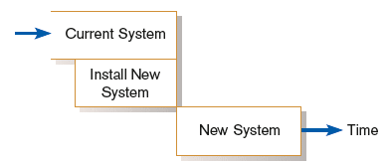
Direct Installation
Direct installation: changing over from the old system to a new one by turning off the old system when the new system is turned on
If the new system fails, the considerable delay may occur until the old system can again be made operational and business transactions are reentered to make the database up to date. For these reasons, direct installation can be very risky.
Figure 13-6
Comparison of installation strategies
(a) Direct installation
Notes:
Direct installation may be simple to do, but it has risks. What if it turns out that something is seriously wrong with the system? We’ve affected everyone!

Slide 28
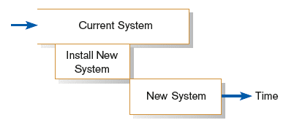
Parallel Installation
Parallel installation: running the old information system and the new one at the same time until management decides the old system can be turned off. Less risky system.
All of the work done by the old system is concurrently performed by the new system. Outputs are compared (to the greatest extent possible) to help determine whether the new system is performing as well as the old.
Figure 13-6
Comparison of installation strategies
(b) Parallel installation
Notes:
Parallel installation has the advantage that user’s can go back to using the old system if the new one has problems. But having two systems up and running on the same environment can affect overall performance, and requires some sort of coordination to avoid duplication of effort (and data).

Slide 29
Single-Location Installation
Single-location installation: trying out an information system at one site and using the experience to decide if and how the new system should be deployed throughout the organization
Also known as location or pilot installation

Slide 30
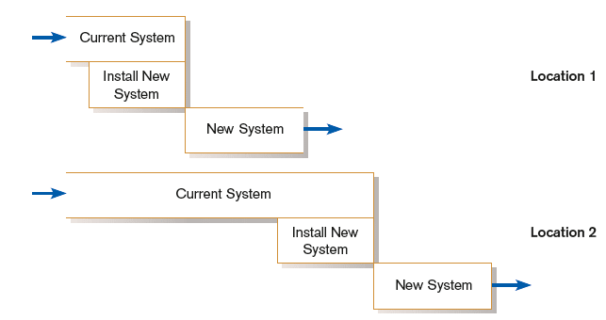
Single-Location Installation (cont.)
Figure 13-6
Comparison of installation strategies
c) Single-location installation (with direct installation at each location)
Notes:
In this scenario, we install the new system for one set of users, but not for another. Sometimes we call this a “pilot” installation, because we have a subset of users to “pilot” the new system. You can almost consider this to be like an extended bit of “beta testing”, which we talked about earlier.

Slide 31
Phased Installation
Phased Installation: changing from the old information system to the new one incrementally, starting with one or a few functional components and then gradually extending the installation to cover the whole new system

Slide 32
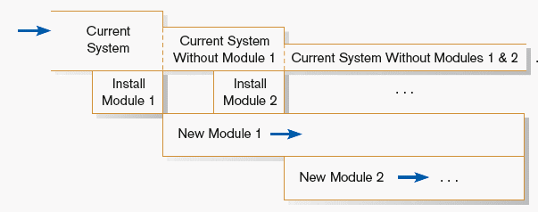
Phased Installation (cont.)
Figure 13-6
Comparison of installation strategies
(d) Phased installation
Notes:
This is pretty complicated to do, because it requires coordination between modules of the old system and modules of the new one.

Slide 33
Planning Installation
Considerations
Data conversion
Error correction
Loading from current system
Planned system shutdown (Off hours are used for installations)
Business cycle of organization
Notes:
An installation strategy involves converting more than just the software. It also involves data conversion, may require new hardware, and definitely requires new documentation and training materials. New systems also typically impact work methods, job descriptions, offices and other facilities.

Slide 34
Documenting the System
System documentation: detailed information about a system’s design specifications, its internal workings, and its functionality
User documentation: written or other visual information about an application system, how it works, and how to use it
Notes:
Every systems development project is unique and will generate its own unique documentation. However, system development projects have many similarities, so there are general rules and types of documentation. One common theme is that some documentation is aimed at technical staff, and other documentation is aimed at users.

Slide 35
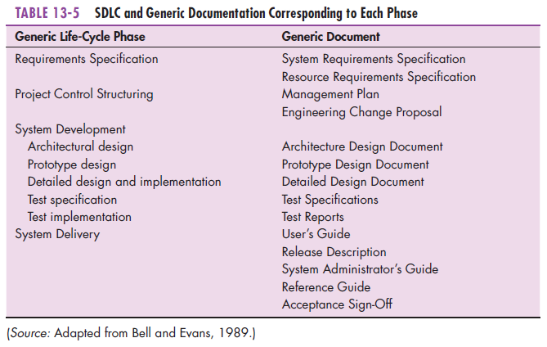
Notes:
As you can see, documentation takes place throughout the life cycle.

Slide 36
Training and Supporting Users
Support: providing ongoing educational and problem-solving assistance to information system users
For in-house developed systems, support materials and jobs will have to be prepared or designed as part of the implementation process.
Notes:
Even with the best documentation, there will usually be additional user support required. This involves both user training and helping users when they run into problems using the system.

Slide 37
Training Information Systems Users
Potential training topics
Use of the system (e.g., how to enter a class registration request)
General computer concepts
Information system concepts
Organizational concepts(e.g., FIFO inventory accounting)
System management
System installation(e.g., how to reconcile current and new systems during phased installation)

Slide 38
Types of Training Methods
Resident expert
Traditional instructor-led classroom training
E-learning, distance learning
Blended learning (instructor plus e-learning)
Software help components
External sources (e.g. vendors)
Notes:
As you can see, there are a multitude of formal and information, human and computerized, training approaches.

Slide 39
Supporting Information Systems Users
Support is important to users, but has often been inadequate.
Providing support can be expensive and time-consuming.
Vendors usually charge for their support, using 900- numbers, or charge a fee for unlimited or monthly support.

Slide 40
Automating Support
One approach is through automation.
Internet-based online support forums and documentation
Voice response systems
Knowledge bases
Notes:
Automated support is less expensive than personal support, so you will often find that vendor hot lines encourage you to use automated resources prior to talking with actual help desk people.

Slide 41
Providing Support Through a Help Desk
Help desk: a single point of contact for all user inquiries and problems about a particular information system or for all users in a particular department

Slide 42
Providing Support Through a Help Desk (Cont.)
Requires
Technical skills: extensive knowledge about how to use the system and typical problems that can be encountered
People skills: good listening and communication, dealing with complaints and frustrations

Slide 43
Support Issues for the Analyst to Consider
User questions and problems
Recovery and backup
Disaster recovery
PC maintenance
Writing newsletters
Setting up user groups
Notes:
As an analyst, you’ll design training for the support staff on the new system and make sure that system documentation will be available to it.

Slide 44
Factors Influencing System Use
Personal stake of users
System characteristics
User demographics
Organizational support
Performance
Satisfaction
Notes:
As we said earlier, the final arbiter of a system’s success is whether it is actually used. Here are some factors that will influence this. Hopefully, many of these factors were addressed during feasibility analysis early in the SDLC. Others are dependent on a good system design, and still others are based on individual users’ attitudes and personalities.

Slide 45
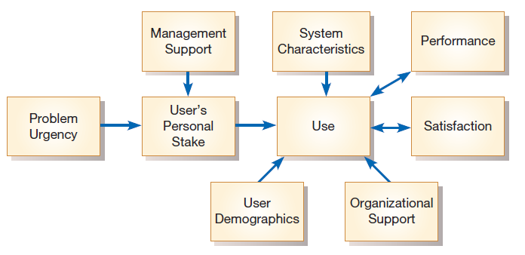
Success Factors
Figure 13-9
Implementation success
(Source: From Henry C. Lucas (1997)
Information Technology for Management.
Copyright © 1997 by McGraw-Hill.
Reprinted by permission.)
Notes:
This is an influence diagram that describes a model of factors influencing whether a system will be used or not. There is actually a large thread of research in the academic information systems literature that analyzes concepts like we see here. One common thread of research involves the “technology acceptance model” and its variants. Here is a Wikipedia link: https://en.wikipedia.org/wiki/Technology_acceptance_model.

Slide 46
Security Issues
Increasingly important issue for organizations and their management
Malicious software (malware): includes Trojan horses, worms, viruses, and other kinds
External sources of threats include laptop theft, system penetration, and denial of service
Weakest link: the user!
Notes:
The weakest link in any computer defense is the people who use the computer system. For example, many system users fail to use good passwords: they may tell other people (including strangers) their passwords, or write their passwords on
sticky notes they post on their computer monitors. The best defensive technology in the world cannot overcome human laziness and negligence.

Slide 47
Project Close-Down
Evaluate team.
Reassign members to other projects.
Notify all affected parties that the development project is ending and that you are switching to operation and maintenance mode.
Conduct post project reviews.
Close out customer contract.
Formal signoff

Slide 48
Summary
In this chapter you learned how to:
Provide an overview of the system implementation process.
Describe how software applications are tested.
Apply four installation strategies: direct, parallel, single-location, and phased installation.
List the deliverables for documenting the system and for training and supporting users.
Explain why system implementation sometimes fails.
Describe the threats to system security and remedies that can be applied.
Show how traditional implementation issues apply to electronic commerce applications.

